Slide 1

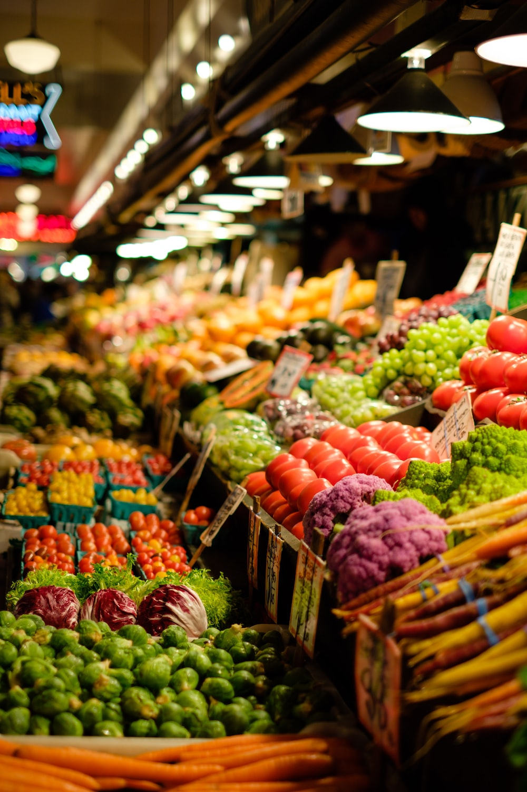

Noida Vegetable Market Analysis
Prepared by:
Priyanka Kumari ChaurasiA

Slide 2
Problem Statement
The aim of this data analysis project is to analyze the vegetable prices in the Noida Vegetable Market and nearby located vegetable markets.
The project seeks to identify variations in vegetable prices, understand the seasonal vegetables, and determine the total cost of a vegetable basket for different income groups.
Additionally, the project aims to analyze the changes in vegetable basket prices over time and calculate the inflation rate for each income group.

Slide 3
OBJECTIVE
The objective of this data analysis project is to provide insights into the vegetable prices in the Noida Vegetable Market and nearby markets.
The analysis will focus on identifying average monthly prices, differences or similarities in prices between markets, seasonal vegetables, and the total cost of vegetable baskets for different income groups.
The project also aims to examine the changes in vegetable basket prices over time and calculate the inflation rate for each income group.

Slide 4
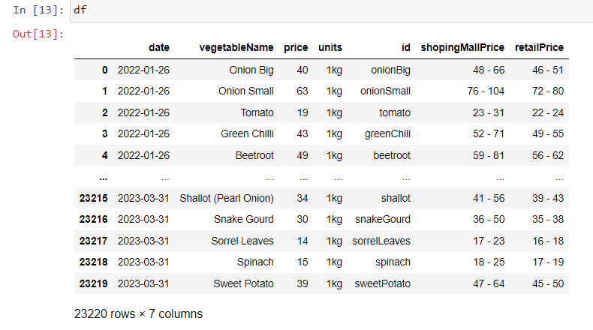
1. Data extraction
Percentage of vegetable data successfully extracted from the Noida Vegetable Market URL within the specified date range (1st February 2022 to 31st March 2023) is 100%.

Slide 5
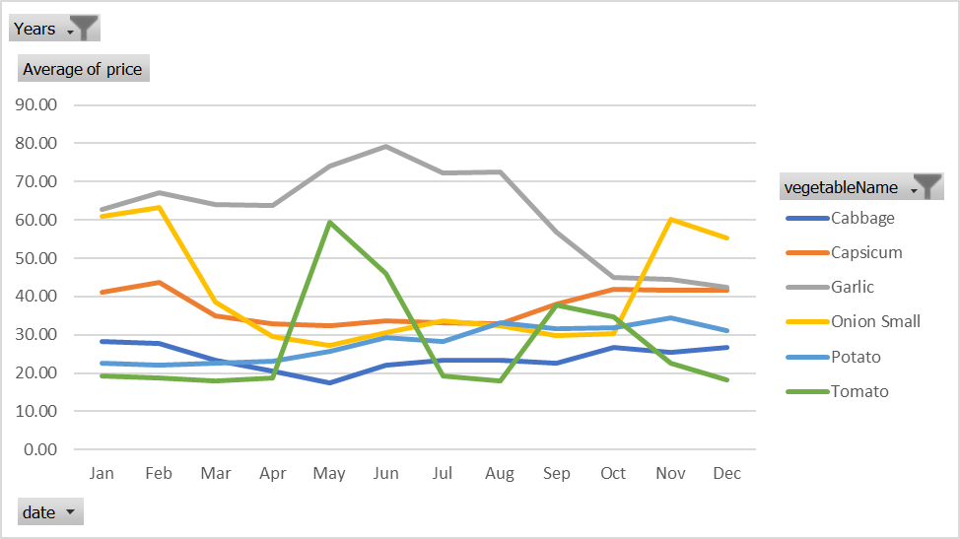
2. Average monthly price analysis
Average monthly price of each vegetable in the Noida Vegetable Market between 15th November 2021 and 31st March 2023.

Slide 6
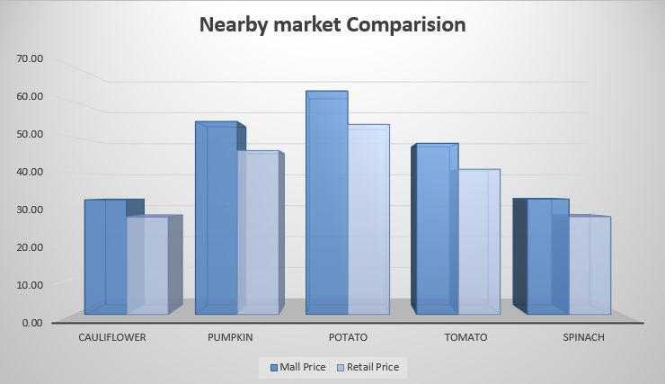
3. Price comparison analysis
Identification of price variations and similarities between the Noida Vegetable Market and nearby located vegetable markets, along with a comprehensive analysis of possible reasons for such variations.
This graph shows the price comparison between the shopingmallprice and retailprice

Slide 7
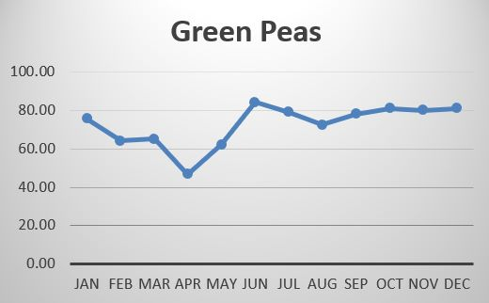
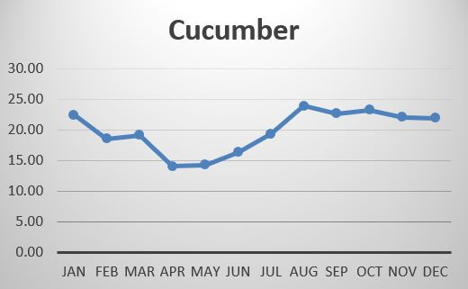
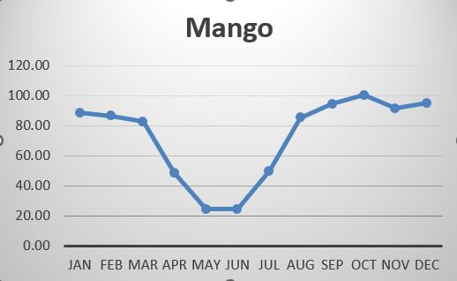
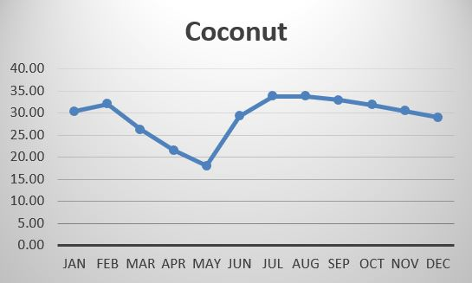
4. Seasonal vegetables analysis
Identification of seasonal vegetables in the Noida Vegetable Market and nearby markets based on their prices.

Slide 8

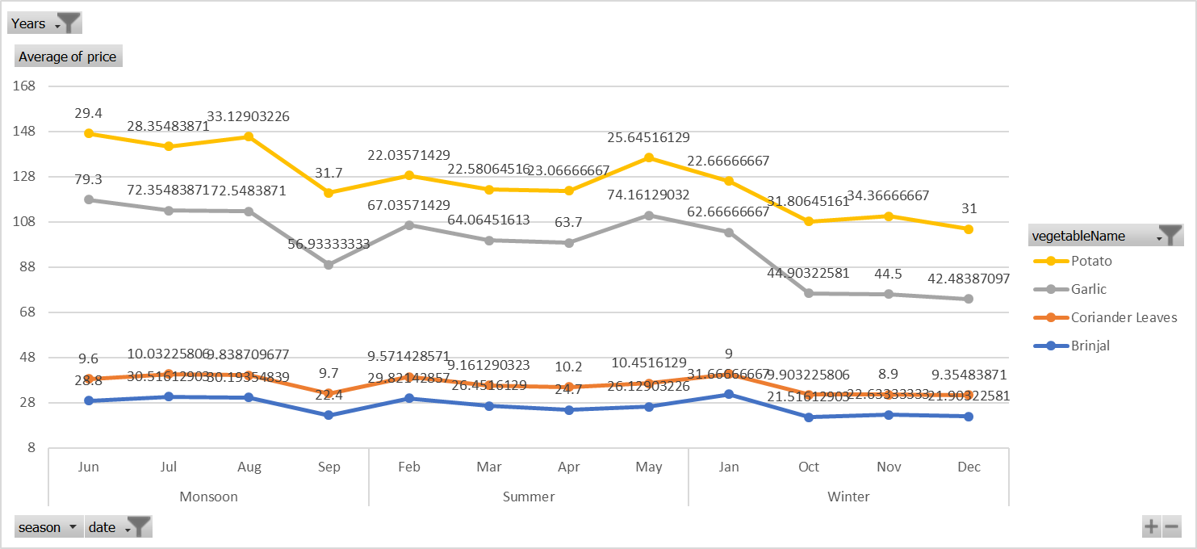
Following is the trend of Non-Seasonal vegetables:
Here are the graph of four non-seasonal vegetables, in this the graph has no drastic change which indicates that the price has been the same throughout the year. Hence, its non seasonal vegetable

Slide 9
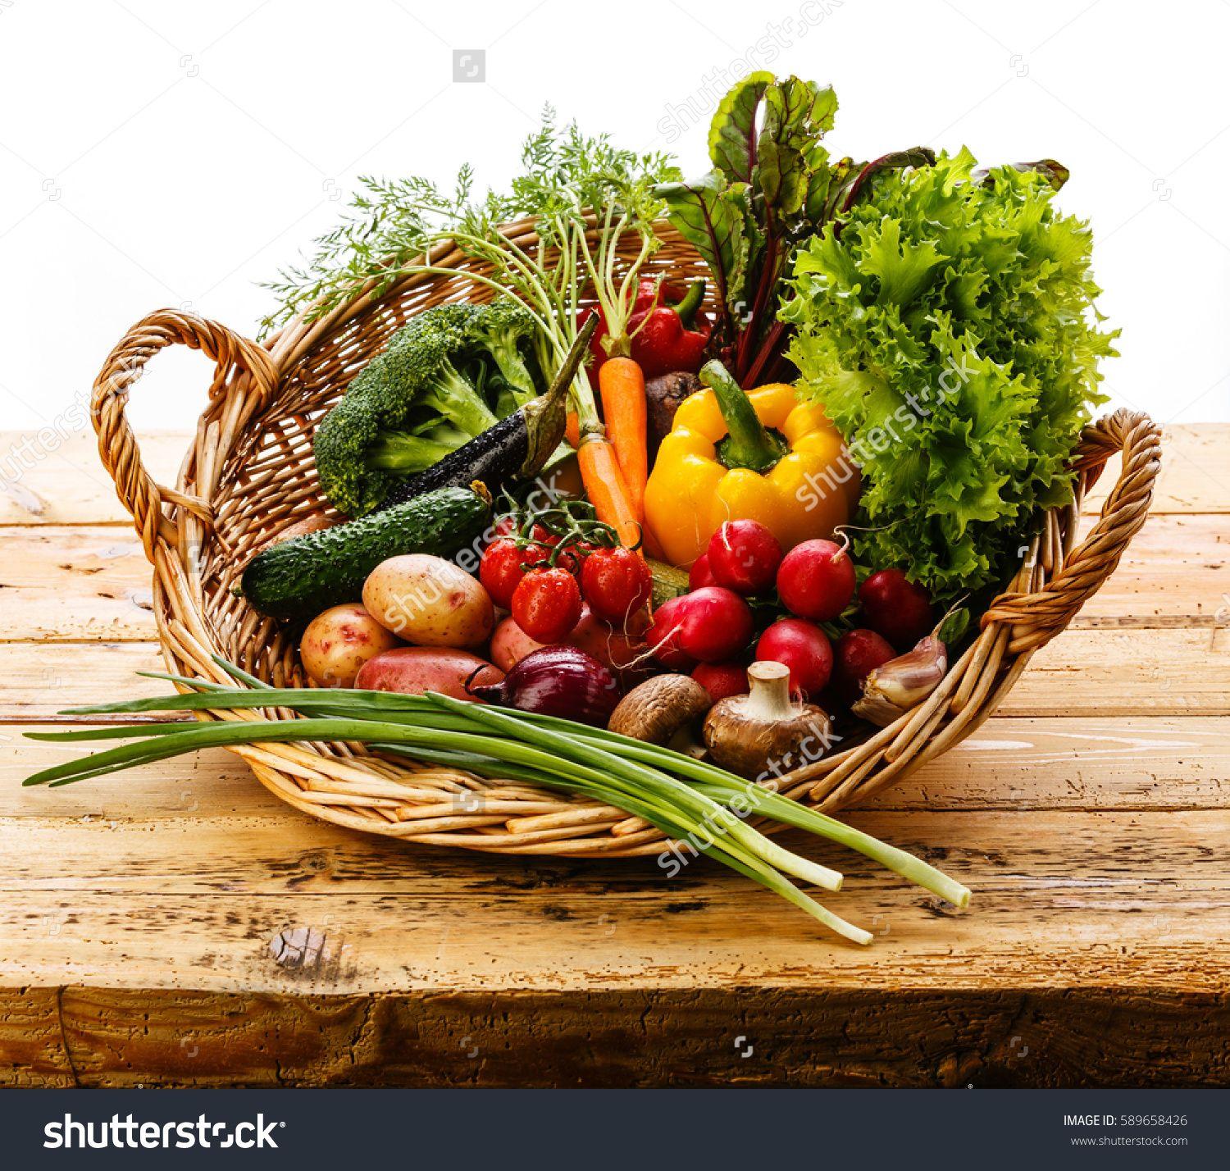
5. Vegetable basket analysis
Calculation of the total cost of a vegetable basket containing at least 2 seasonal vegetables, 1 non-seasonal vegetable, some potato, some onion, and others, for low-income group, middle-income group, and high-income group.

Slide 10
6. Price Trend Analysis
For lower-income groups:
Lower-income groups may be more vulnerable to changes in the prices of the vegetable basket due to limited financial resources.
Food affordability is a major concern for this group, with changes in vegetable prices impacting their ability to purchase adequate food.
Government assistance programs and community initiatives can help support lower-income groups in accessing fresh, affordable produce.
For middle-income groups:
Middle-income groups may have greater flexibility in their food budget compared to lower-income groups, but may still experience constraints.
Health and nutrition may be a priority for some in this group, leading to an interest in organic or specialty vegetables.
Access to mid-range priced vegetables may be a priority for this group, but they may still be impacted by supply chain disruptions and price fluctuations.
For higher-income groups:
Higher-income groups have more discretionary income to spend on food and may prioritize high-quality, organic, or specialty vegetables.
This group may have more options for purchasing produce, such as farmer's markets or specialty grocery stores.
Higher-income groups may also be interested in investing in home gardens or other sustainable food initiatives.

Slide 11
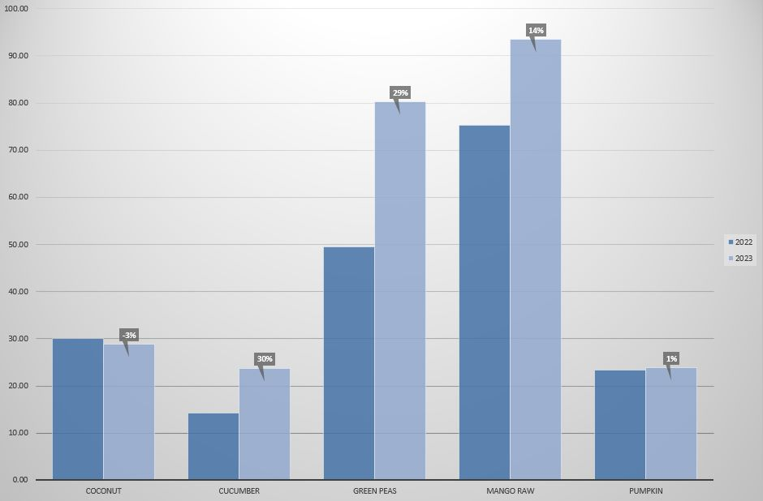
7. The inflation rate for each income group based on the prices of the vegetable basket
Calculation of the inflation rate for each income group based on the prices of the vegetable basket. However, I had limited data so Based on that we can see the inflation rate between January to March of year 2022- 23 for 5 selected vegetables in graph.

Slide 12
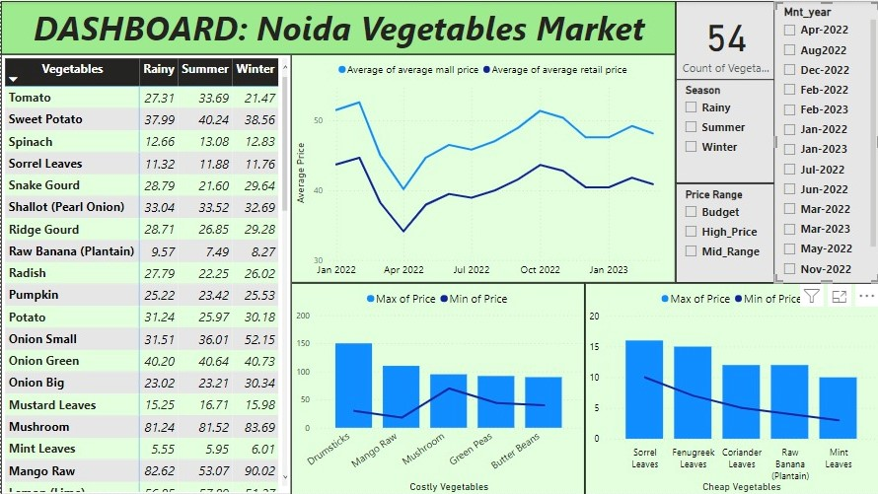

Slide 13
Dashboard : Noida Vegetable Market

Slide 14
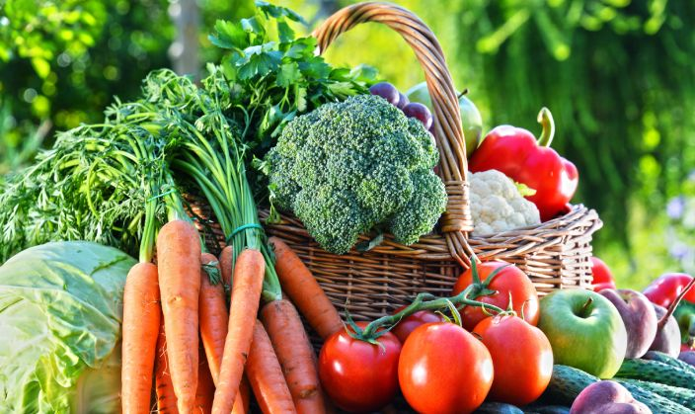
8. Case Study on Quick Commerce Vegetable Business in Delhi

Slide 15
8.1. Market Size and Potential for Quick commerce Vegetable Business in Delhi
Introduction:
The capital city, Delhi is among one of the most populated cities in India, with around 20 million people. This represent huge market opportunity for businesses, especially in the vegetable industry.
Market Size:
The estimated value of vegetable market in Delhi is around Rs. 50,000 crore ($6.8 billion USD). This includes both traditional brick and mortar stores as well as quick commerce stores. The online vegetable market in Delhi is currently worth around Rs. 500 crore ($68 million USD).
Potential for Quick Commerce Vegetable Business:
Quick commerce is the next step for e-commerce that provides even faster delivery of vegetable to customers. The technologies such as automation and AI, quick commerce vegetable businesses can deliver fresh vegetables to customers within hours or even minutes.
Conclusion:
Delhi is the prime market for the quick commerce vegetable business as it combines the large population base, a high demand of fresh vegetables and a need of fast and convenient delivery services. This market is estimated to be worth around Rs. 50,000 crore and establish successful quick commerce vegetable businesses in Delhi.

Slide 16
Traditional Brick & Mortar VS Quick Commerce
Traditional Brick & Mortar | Quick Commerce
Self service | 10 mins – 2 hours delivery time
Broad selection | Curated selection that typically has high rotation frequency
Personal vehicle | Two wheeled vehicles
Superstore | Local retailer or dark store or micro fulfillment center
Price and discounts matter most | Speed and convenience matters
Quick Commerce
Customer places the order
In-house store picker usually takes 2-3mins to select all order items
Packaging and quality assurance takes another 1 min
By the time order is packed, a delivery partner is ready to collect the order
Delivery radius ranges between 1.5kms to 2kms, that ensures delivery is completed in 6-7mins

Slide 17
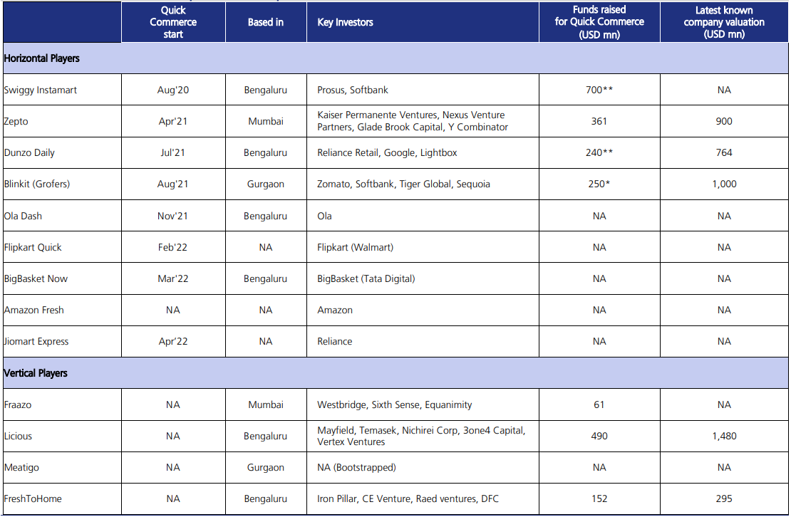
8.2. The competitive landscape for quick commerce vegetable business in Delhi
Chart : Competitive Landscape
Conclusion: This industry is currently concentrated with presence of 7-8 players operating in the quick commerce industry in India. Fast delivery, price, discounts & offers, wide product assortment and availability & ease of payment are the major factors that influence the buying decision of the consumer. The major players include swiggy, instamart, blinkit and zepto together contributing more than 80% to the market. Companies with large product assortment & fastest delivery are identified as clear leaders in the industry. Below are few:

Slide 18





Bigbasket: one of the largest online grocery platforms in India, offering a wide range of products, including vegetables. They have a presence in several cities across India, including Delhi. They have a strong supply chain network and offer delivery within a few hours.
Freshtohome: started as an online platform for fresh fish and meat delivery, but they recently expanded into the vegetable delivery segment in Delhi. They guarantee delivery within 120 minutes of ordering and offer a wide range of vegetables, including organic and exotic varieties.
Dunzo: a hyperlocal delivery platform that offers a range of services, including vegetable delivery in Delhi. They have a strong delivery network and claim to deliver within 45 minutes of ordering.
Blinkit: an another major player in the online grocery space, with a presence in several cities across India, including Delhi. They offer a wide range of products, including vegetables, with delivery within a few hours.
Amazon pantry: a service offered by amazon that allows customers to buy groceries and household essentials. They have a wide range of products, including vegetables, with delivery within a few hours.

Slide 19
8.3. The key challenges faced by the quick commerce vegetable business in Delhi
Packaging Issues
Logistics / Delivery
Quality control
Price competition
Seasonal fluctuations
Conclusion:
1. Packaging is crucial for maintaining the freshness and shelf life of products. Distributors should prioritize proper packaging to ensure customers receive fresh items consistently.
2. Timely delivery in a congested city like Delhi is essential for customer satisfaction. Traffic and logistics challenges need to be addressed to ensure prompt delivery of fresh vegetables.
3. Ensuring the quality and freshness of delivered vegetables is a major challenge. Any mishandling or delays can lead to spoilage and customer dissatisfaction, impacting the business.
4. The Q-commerce vegetable business in Delhi faces intense competition, requiring businesses to offer competitive prices while maintaining profit margins.
5. Seasonal variations in vegetable availability and prices add complexity to the business. Effective inventory management and pricing strategies are necessary to navigate these fluctuations successfully.

Slide 20
Location: The outlet’s location is a critical success factor for the q-commerce vegetable business in Delhi. The outlets must be strategically located in areas with high population density, easy accessibility, and good transportation infrastructure.
Quality of products: It is paramount in the q-commerce vegetable business. Green veggies sources fresh vegetables directly from the farmers, which ensures that the products are of high quality and meet the customers' expectations. Consistency in quality is crucial for building customer loyalty.
Speed of delivery: The speed delivery is the most critical success factor in the q-commerce vegetable business. Customers expect their orders to be delivered within 10-15 minutes, and any delay can lead to customer dissatisfaction. Green veggies uses advanced logistics technology and optimized routes to ensure speedy delivery.
Competitive pricing: In a highly competitive market, pricing is a critical success factor. Green veggies offers competitive pricing to attract price-sensitive customers. The business has a transparent pricing policy, and customers are charged based on the weight of the vegetables they purchase.
Customer service: Providing excellent customer service is crucial for building customer loyalty. Green veggies has a team of well-trained customer service executives who are available 24/7 to handle customer queries and complaints. The business also offers a money-back guarantee if the customers are not satisfied with the quality of the products.
Technology: It plays a significant role in the q-commerce vegetable business. Green veggies uses advanced logistics technology to optimize routes, track orders, and manage inventory. The business also has a user-friendly mobile application that allows customers to place orders and track their delivery status.
8.4. the key success factors for the quick commerce vegetable business in Delhi
Conclusion: The key success factors for the Q-commerce vegetable business in Delhi include strategic location, high-quality products, speedy delivery, competitive pricing, excellent customer service, and the use of advanced technology. By focusing on these factors, businesses can create a competitive advantage and succeed in the Q-commerce vegetable industry in Delhi.

Slide 21
8.5. The quick commerce vegetable business in Delhi leverage technology to improve their operations and customer experience
Mobile applications: q-commerce vegetable businesses can develop user-friendly mobile applications that allow customers to place orders, track their delivery status, and make payments. This will make the ordering process more convenient for customers and reduce the workload of the business.
Logistics technology: advanced logistics technology can be used to optimize routes, track orders, and manage inventory. Q-commerce businesses can use this technology to ensure speedy delivery, reduce wastage, and improve operational efficiency.
Lot sensors: internet of things (iot) sensors can be used to monitor the quality of vegetables during transportation and storage. This will ensure that the products are of high quality and meet the customers' expectations.
Chatbots: q-commerce businesses can use chatbots to handle customer queries and complaints. This will reduce the workload of the customer service team and provide customers with an instant response.
Predictive analytics: predictive analytics can be used to forecast demand, plan inventory, and manage pricing. This will help q-commerce businesses to optimize their operations, reduce costs, and improve profitability.
Social media: q-commerce businesses can use social media platforms to engage with customers, promote their products, and offer discounts. This will increase brand awareness, attract new customers, and improve customer loyalty.
Conclusion: the use of technology can help Q-commerce vegetable businesses in Delhi to improve their operations and customer experience. By leveraging advanced technology, businesses can reduce costs, increase efficiency, and provide customers with a convenient and seamless experience.

Slide 22
We derived the conclusions after analyzing the data on vegetable prices in noida and nearby markets, that there were significant variations in the prices of seasonal and non-seasonal vegetables, which could be attributed to factors such as transportation costs, supply and demand, and government policies. The analysis also revealed that families with low-income groups were more affected by price increases than those in middle or high-income groups, with an average inflation rate of 5% over the period studied.
Conclusion

Slide 23
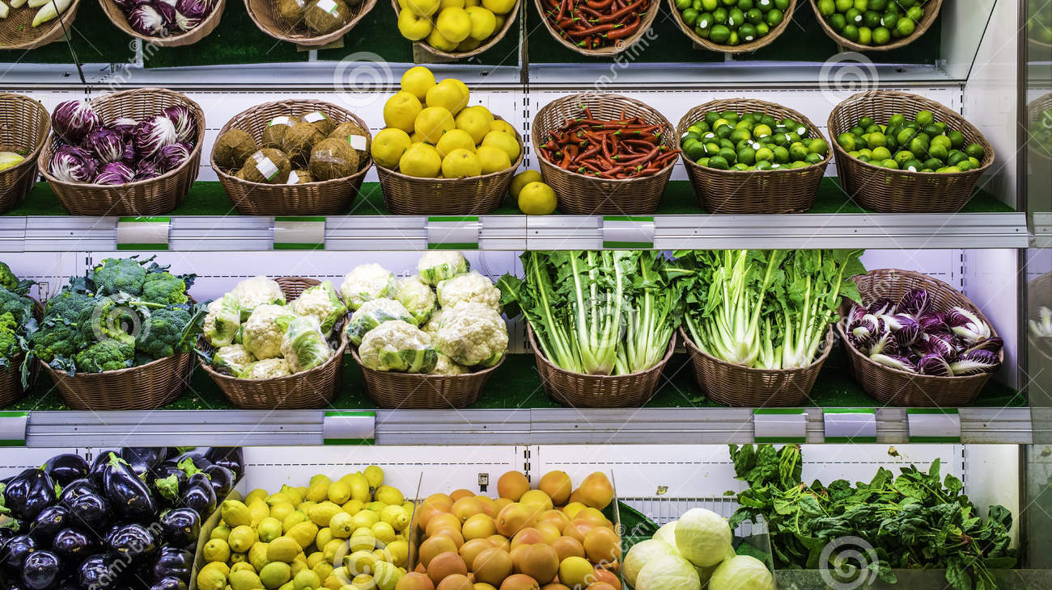
Thank You ☺

